Slide 1
Asymptotic Notation,
Review of Functions & Summations
Comp 122, Spring 2004

Slide 2
Asymptotic Complexity
Running time of an algorithm as a function of input size n for large n.
Expressed using only the highest-order term in the expression for the exact running time.
  Instead of exact running time, say Θ(n²).
Describes behavior of function in the limit.
Written using Asymptotic Notation.
Comp 122

Slide 3
Asymptotic Notation
Θ, O, Ω, o, ω
Defined for functions over the natural numbers.
  Ex: f(n) = Θ(n²).
  Describes how f(n) grows in comparison to n².
Define a set of functions; in practice used to compare two function sizes.
The notations describe different rate-of-growth relations between the defining function and the defined set of functions.
Comp 122

Slide 4

Θ-notation
For function g(n), we define Θ(g(n)), big-Theta of n, as the set:
Θ(g(n)) = {f(n) :
∃ positive constants c₁, c₂, and n_{0,} such that ∀n ≥ n₀,
we have 0 ≤ c₁g(n) ≤ f(n) ≤ c₂g(n)
}
Intuitively: Set of all functions that
have the same rate of growth as g(n).
g(n) is an asymptotically tight bound for f(n).
Comp 122

Slide 5
Θ-notation
For function g(n), we define Θ(g(n)), big-Theta of n, as the set:
Θ(g(n)) = {f(n) :
∃ positive constants c₁, c₂, and n_{0,} such that ∀n ≥ n₀,
we have 0 ≤ c₁g(n) ≤ f(n) ≤ c₂g(n)
}
Technically, f(n) ∈ Θ(g(n)).
Older usage, f(n) = Θ(g(n)).
I’ll accept either…
f(n) and g(n) are nonnegative, for large n.
Comp 122

Slide 6
Example
Θ(g(n)) = {f(n) : ∃ positive constants c₁, c₂, and n₀, such that ∀n ≥ n₀, 0 ≤ c₁g(n) ≤ f(n) ≤ c₂g(n)}
10n² - 3n = Θ(n²)
What constants for n₀, c₁, and c₂ will work?
Make c₁ a little smaller than the leading coefficient, and c₂ a little bigger.
To compare orders of growth, look at the leading term.
Exercise: Prove that n²/2-3n= Θ(n²)
Comp 122

Slide 7
Example
Θ(g(n)) = {f(n) : ∃ positive constants c₁, c₂, and n₀, such that ∀n ≥ n₀, 0 ≤ c₁g(n) ≤ f(n) ≤ c₂g(n)}
Is 3n³ ∈ Θ(n⁴) ??
How about 2^{2n}∈ Θ(2^{n})??
Comp 122

Slide 8

O-notation
For function g(n), we define O(g(n)), big-O of n, as the set:
O(g(n)) = {f(n) :
∃ positive constants c and n_{0,} such that ∀n ≥ n₀,
we have 0 ≤ f(n) ≤ cg(n) }
Intuitively: Set of all functions whose rate of growth is the same as or lower than that of g(n).
g(n) is an asymptotic upper bound for f(n).
f(n) = Θ(g(n)) ⇒ f(n) = O(g(n)).
Θ(g(n)) ⊂ O(g(n)).
Comp 122

Slide 9
Examples
O(g(n)) = {f(n) : ∃ positive constants c and n₀, such that ∀n ≥ n₀, we have 0 ≤ f(n) ≤ cg(n) }
Any linear function an + b is in O(n²). How?
Show that 3n³=O(n⁴) for appropriate c and n₀.
Comp 122

Slide 10

Ω -notation
For function g(n), we define Ω(g(n)), big-Omega of n, as the set:
Ω(g(n)) = {f(n) :
∃ positive constants c and n_{0,} such that ∀n ≥ n₀,
we have 0 ≤ cg(n) ≤ f(n)}
Intuitively: Set of all functions whose rate of growth is the same as or higher than that of g(n).
g(n) is an asymptotic lower bound for f(n).
f(n) = Θ(g(n)) ⇒ f(n) = Ω(g(n)).
Θ(g(n)) ⊂ Ω(g(n)).
Comp 122

Slide 11
Example
√n = Ω(lg n). Choose c and n₀.
Ω(g(n)) = {f(n) : ∃ positive constants c and n₀, such that ∀n ≥ n₀, we have 0 ≤ cg(n) ≤ f(n)}
Comp 122

Slide 12
Relations Between Θ, O, Ω
Comp 122

Slide 13
Relations Between Θ, Ω, O
Theorem : For any two functions g(n) and f(n),
f(n) = Θ(g(n)) iff
f(n) = O(g(n)) and f(n) = Ω(g(n)).
I.e., Θ(g(n)) = O(g(n)) ∩ Ω(g(n))
In practice, asymptotically tight bounds are obtained from asymptotic upper and lower bounds.
Comp 122

Slide 14
Running Times
“Running time is O(f(n))” ⇒ Worst case is O(f(n))
O(f(n)) bound on the worst-case running time ⇒ O(f(n)) bound on the running time of every input.
Θ(f(n)) bound on the worst-case running time ⇒ Θ(f(n)) bound on the running time of every input.
“Running time is Ω(f(n))” ⇒ Best case is Ω(f(n))
Can still say “Worst-case running time is Ω(f(n))”
  Means worst-case running time is given by some unspecified function g(n) ∈ Ω(f(n)).
Comp 122

Slide 15
Example
Insertion sort takes Θ(n²) in the worst case, so sorting (as a problem) is O(n²). Why?
Any sort algorithm must look at each item, so sorting is Ω(n).
In fact, using (e.g.) merge sort, sorting is Θ(n lg n) in the worst case.
  Later, we will prove that we cannot hope that any comparison sort to do better in the worst case.
Comp 122

Slide 16
Asymptotic Notation in Equations
Can use asymptotic notation in equations to replace expressions containing lower-order terms.
For example,
  4n³ + 3n² + 2n + 1 = 4n³ + 3n² + Θ(n)
  = 4n³ + Θ(n²) = Θ(n³). How to interpret?
In equations, Θ(f(n)) always stands for an anonymous function g(n) ∈ Θ(f(n))
  In the example above, Θ(n²) stands for
  3n² + 2n + 1.
Comp 122

Slide 17
o-notation
For a given function g(n), the set little-o:
o(g(n)) = {f(n): ∀ c > 0, ∃ n₀ > 0 such that
∀ n ≥ n₀, we have 0 ≤ f(n) < cg(n)}.
f(n) becomes insignificant relative to g(n) as n approaches infinity:
lim [f(n) / g(n)] = 0
^{n→∞}
g(n) is an upper bound for f(n) that is not asymptotically tight.
Observe the difference in this definition from previous ones. Why?
Comp 122

Slide 18
ω -notation
For a given function g(n), the set little-omega:
ω(g(n)) = {f(n): ∀ c > 0, ∃ n₀ > 0 such that
∀ n ≥ n₀, we have 0 ≤ cg(n) < f(n)}.
f(n) becomes arbitrarily large relative to g(n) as n approaches infinity:
lim [f(n) / g(n)] = ∞.
^{n→∞}
g(n) is a lower bound for f(n) that is not asymptotically tight.
Comp 122

Slide 19
Comparison of Functions
f ↔ g ≈ a ↔ b
f (n) = O(g(n)) ≈ a ≤ b
f (n) = Ω(g(n)) ≈ a ≥ b
f (n) = Θ(g(n)) ≈ a = b
f (n) = o(g(n)) ≈ a < b
f (n) = ω (g(n)) ≈ a > b
Comp 122

Slide 20
Limits
lim [f(n) / g(n)] = 0 ⇒ f(n) ∈ ο(g(n))
^{n→∞}
lim [f(n) / g(n)] < ∞ ⇒ f(n) ∈ Ο(g(n))
^{n→∞}
0 < lim [f(n) / g(n)] < ∞ ⇒ f(n) ∈ Θ(g(n))
^{n→∞}
0 < lim [f(n) / g(n)] ⇒ f(n) ∈ Ω(g(n))
^{n→∞}
lim [f(n) / g(n)] = ∞ ⇒ f(n) ∈ ω(g(n))
^{n→∞}
lim [f(n) / g(n)] undefined ⇒ can’t say
^{n→∞}
Comp 122

Slide 21
Properties
Transitivity
f(n) = Θ(g(n)) & g(n) = Θ(h(n)) ⇒ f(n) = Θ(h(n))
f(n) = O(g(n)) & g(n) = O(h(n)) ⇒ f(n) = O(h(n))
f(n) = Ω(g(n)) & g(n) = Ω(h(n)) ⇒ f(n) = Ω(h(n))
f(n) = o (g(n)) & g(n) = o (h(n)) ⇒ f(n) = o (h(n))
f(n) = ω(g(n)) & g(n) = ω(h(n)) ⇒ f(n) = ω(h(n))
Reflexivity
f(n) = Θ(f(n))
f(n) = O(f(n))
f(n) = Ω(f(n))
Comp 122

Slide 22
Properties
Symmetry
f(n) = Θ(g(n)) iff g(n) = Θ(f(n))
Complementarity
f(n) = O(g(n)) iff g(n) = Ω(f(n))
f(n) = o(g(n)) iff g(n) = ω((f(n))
Comp 122

Slide 23
Common Functions
Comp 122, Spring 2004

Slide 24
Monotonicity
f(n) is
  monotonically increasing if m ≤ n ⇒ f(m) ≤ f(n).
  monotonically decreasing if m ≥ n ⇒ f(m) ≥ f(n).
  strictly increasing if m < n ⇒ f(m) < f(n).
  strictly decreasing if m > n ⇒ f(m) > f(n).
Comp 122

Slide 25
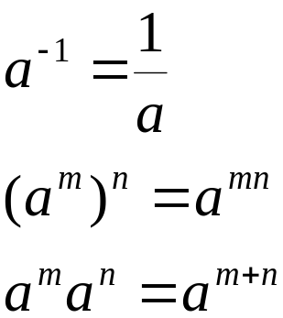
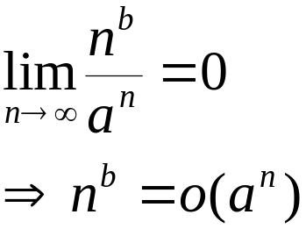
Exponentials
Useful Identities:
Exponentials and polynomials
Comp 122

Slide 26
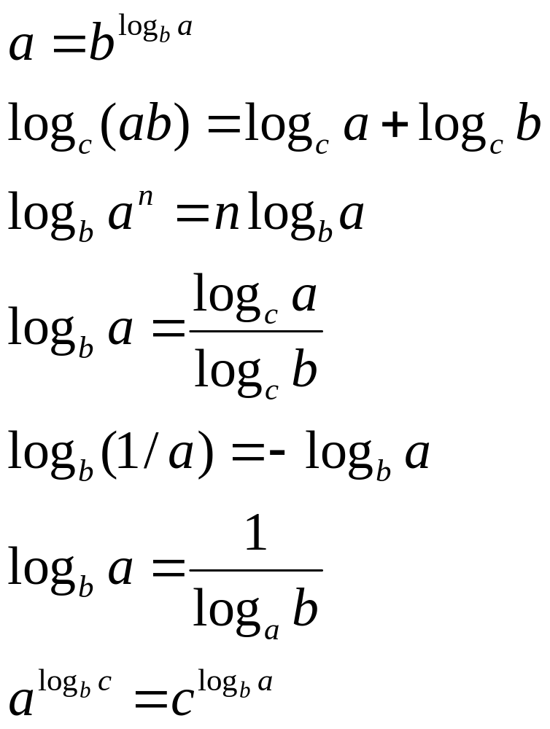
Logarithms
x = log_{b}a is the
exponent for a = b^{x}.
Natural log: ln a = log_{e}a
Binary log: lg a = log₂a
lg²a = (lg a)²
lg lg a = lg (lg a)
Comp 122

Slide 27
Logarithms and exponentials – Bases
If the base of a logarithm is changed from one constant to another, the value is altered by a constant factor.
  Ex: log₁₀ n * log₂10 = log₂ n.
  Base of logarithm is not an issue in asymptotic notation.
Exponentials with different bases differ by a exponential factor (not a constant factor).
  Ex: 2^{n} = (2/3)^{n}*3^{n}.
Comp 122

Slide 28
Polylogarithms
For a ≥ 0, b > 0, lim _{n→∞} ( lgª n / n^{b} ) = 0,
so lgª n = o(n^{b}), and n^{b} = ω(lgª n )
  Prove using L’Hopital’s rule repeatedly
lg(n!) = Θ(n lg n)
  Prove using Stirling’s approximation (in the text) for lg(n!).
Comp 122

Slide 29
Exercise
Express functions in A in asymptotic notation using functions in B.
A B
5n² + 100n 3n² + 2
A ∈ Θ(B)
A ∈ Θ(n²), n² ∈ Θ(B) ⇒ A ∈ Θ(B)
log₃(n²) log₂(n³)
A ∈ Θ(B)
  log_{b}a = log_{c}a / log_{c}b; A = 2lgn / lg3, B = 3lgn, A/B =2/(3lg3)
n^{lg4} 3^{lg n}
A ∈ ω(B)
a^{log b} = b^{log a}; B =3^{lg n}=n^{lg 3}; A/B =n^{lg(4/3)} → ∞ as n→∞
lg²n n^{1/2}
A ∈ ο (B)
  lim ( lgª n / n^{b} ) = 0 (here a = 2 and b = 1/2) ⇒ A ∈ ο (B)
  ^{n→∞}
Comp 122

